Slide 1

CANDLE STICKS AND CHART PATTERNS
We’ve established in previous sessions that when traders analyze the market, their primary goal is to extract the given market sentiment from the candle stick chart and make trade decision in respect to their trading strategy.
Now, it’s safe to say that candle sticks and chart-patterns can be likened to alphabets and letters respectively; hence learning to read and understand them, implies being able to understand the language of the financial market.

Slide 2
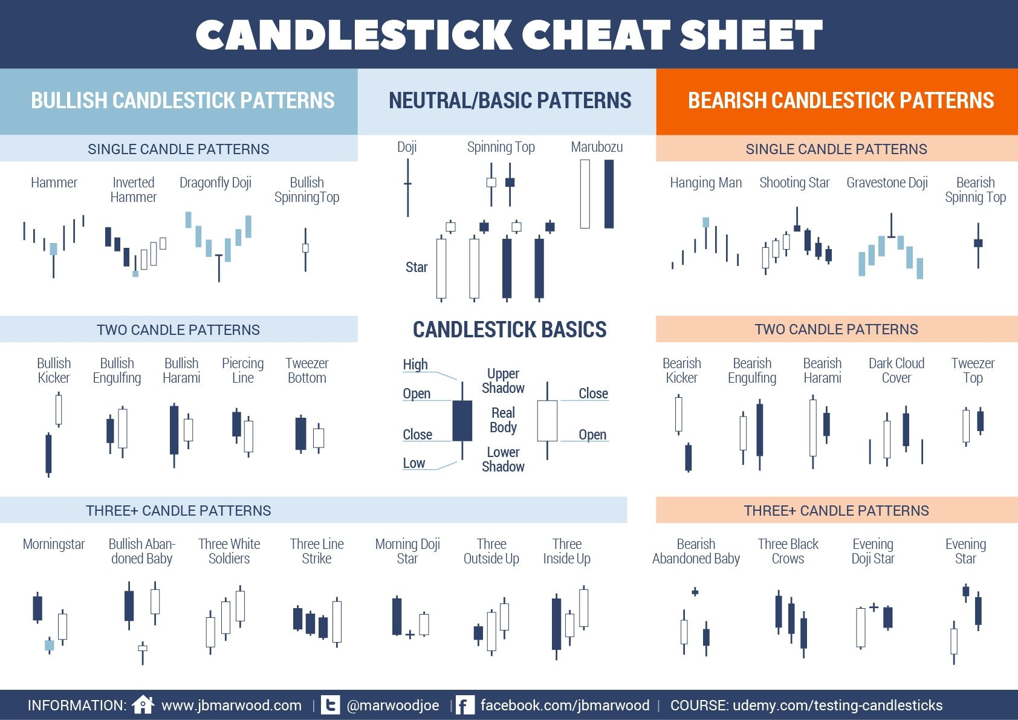

Slide 3
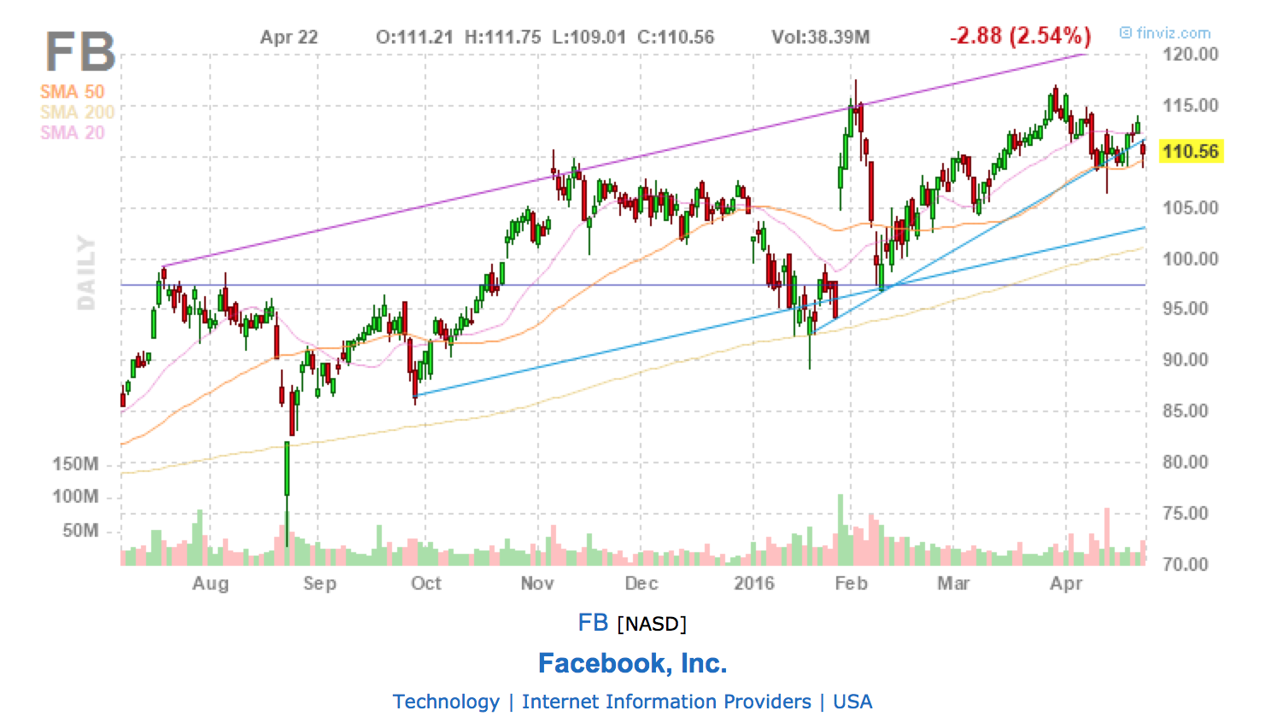
CANDLE-STICK PATTERNS
A chart pattern is a visual formation or shape within a price chart that provides clues to what prices might do next.
They tell the story of the given market sentiment from a broad perspective. Hence we have a framework to analyze the battle between bulls and bears. with this, the stronger power can be determined, allowing traders to position themselves accordingly.

Slide 4
LIST OF CLASSIC CHART PATTERNS
Double Tops and Double Bottoms
Heads and shoulders (inverse and none-inverse)
Rising and Falling Wedges
Bullish and Bearish Rectangles
Bearish and Bullish Pennants
Triangles (Symmetrical, Ascending, and Descending)

Slide 5
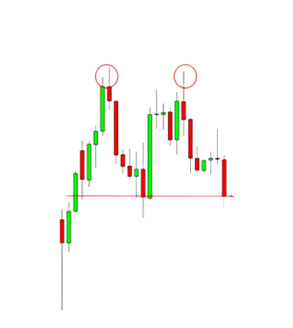
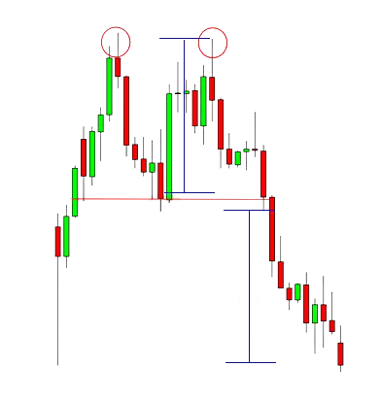
HOW TO IDENTIFY AND TRADE CHART PATTERNS
Two tops
One top
Double Tops
The “tops” are peaks that are formed when the price hits a certain level that can’t be broken.
A double top is a reversal pattern that is formed after there is an extended move up.
We are to place our entry order below the neckline because we are anticipating a reversal of the uptrend.
Neck Line
Looking at the chart you can see that the price breaks the neckline and makes a nice move down.
Price drops down

Slide 6
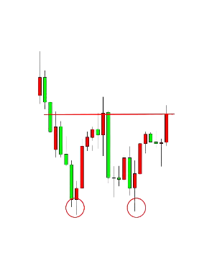
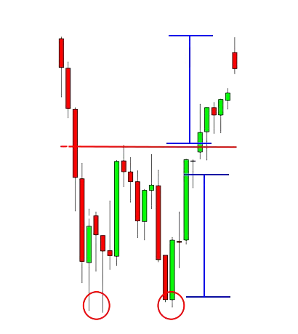
Double Bottoms
The double bottom is also a trend reversal formation, but this time we are looking to go long instead of short.
neckline
Notice how the second bottom wasn’t able to significantly break the first bottom.
first bottom
This is a sign that the selling pressure is about finished, and that a reversal is about to occur.
second bottom
With the double bottom, we would place our entry order above the neckline because we are anticipating a reversal of the down trend.
price moves up
neckline
Looking at the chart you can see that the price breaks the neckline and makes a nice move down.

Slide 7
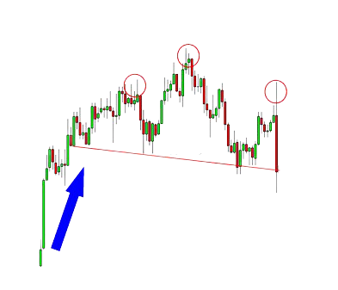
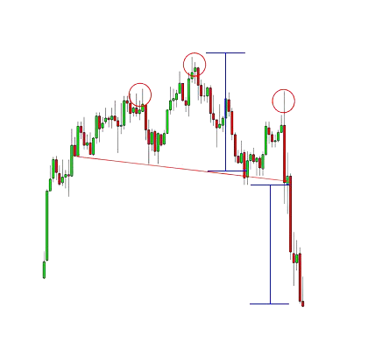
Head and shoulders
Like the double bottom and tops, the head and shoulders pattern is also a trend reversal formation.
Head
First shoulder
Second shoulder
The head is the second peak and is the highest point in the pattern. The two shoulders also form peaks but do not exceed the height of the head.
neckline
A “neckline” is drawn by connecting the lowest points of the two troughs.
With this formation, we put an entry order below the neckline.
neckline
You can see that once the price goes below the neckline it makes a move that is at least the size of the distance between the head and the neckline.
Price drops

Slide 8
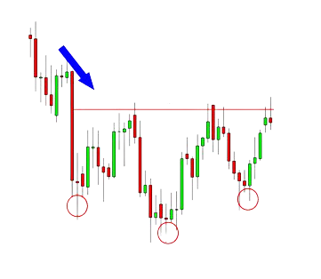
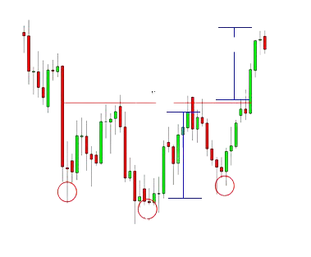
Inverse Head and shoulders
These formations occur after extended downward movements.
Neckline
This is just like a head and shoulders pattern, but it’s flipped upside down.
With this formation, we would place a long entry order above the neckline.
Shoulder
Shoulder
Head
Price moves up
Measure the distance between the head and the neckline, and that is approximately the distance that the price will move after it breaks the neckline.
Neckline

Slide 9
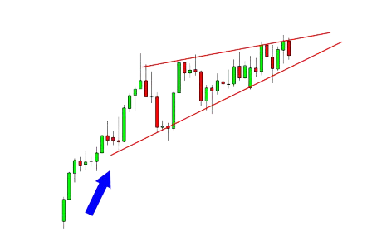
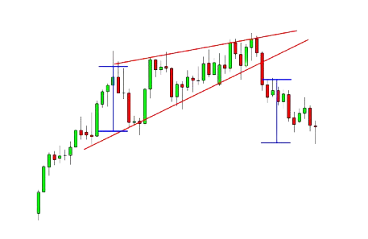
Rising Wedge
Upward sloping resistance
A rising wedge is formed when the price consolidates between upward sloping support and resistance lines.
Consolidation
The slope of the support line should be steeper than that of the resistance.
Upward sloping support
With prices consolidating, we can expect a breakout to either the top or bottom.
If the rising wedge forms after an uptrend, it’s usually a bearish reversal pattern.
Downward price break out
On the other hand, it could signal a continuation of the down move if it forms during a downtrend.

Slide 10
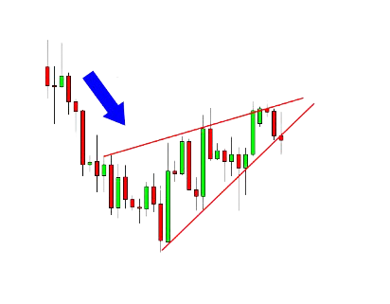
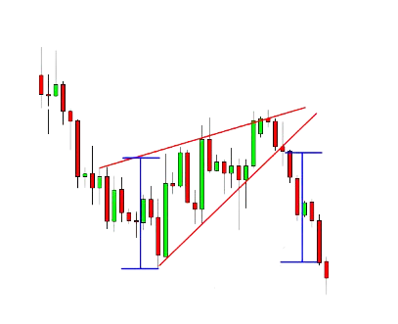
Let’s take a look at another example of a rising wedge formation. Only this time it acts as a Bearish continuation signal
Price came from a downtrend before consolidating and sketching higher highs and even higher lows.
Down Trend
Consolidation
Down Trend resumes
from price breakout

Slide 11
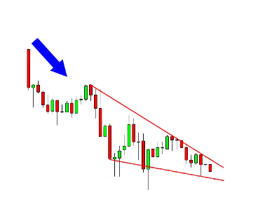
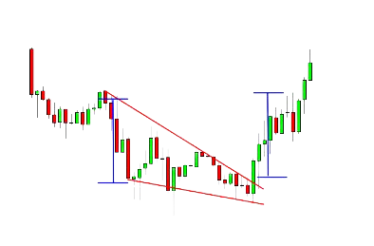
Falling Wedge
Downtrend
Unlike the rising wedge, the falling wedge is a bullish chart pattern.
Lower Highs
Like the rising wedge, the falling wedge can either be a reversal or continuation signal.
In this example, the falling wedge serves as a reversal signal. After a downtrend, the price made lower highs and lower lows.
Lower lows
In this case, at the upward break out,…price went a few more pips beyond that target!
Price breaks out upwards

Slide 12
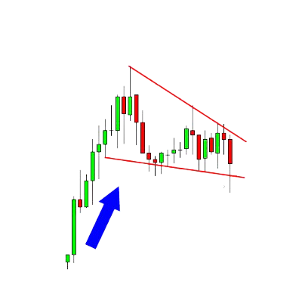
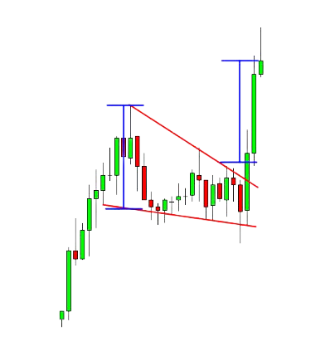
Here is an example where the falling wedge serves as a continuation signal.
Price consolidated for a bit after a strong rally. This could mean that price tapered down from bulls exhaustion.
Soon afterwards price broke to the top side with a strong move
Lower Highs
Price upward break out signals continuation of uptrend
Lower lows
Uptrend

Slide 13
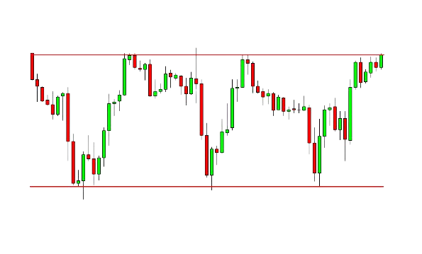
Rectangles
Resistance
A rectangle is a chart pattern formed when the price is bound by parallel support and resistance levels.
In the example above, we can clearly see that the pair was bound by two major price levels which are parallel to one another.
Support
To place entries with rectangles, we wait until one of these levels get broken through before we buy or sell.

Slide 14
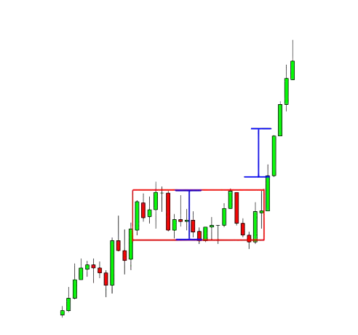
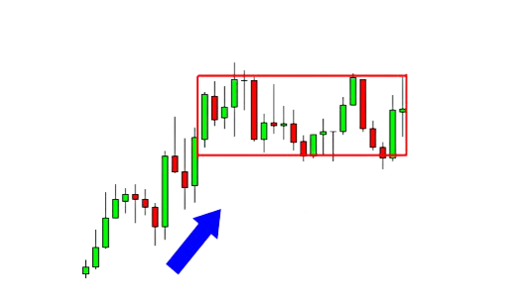
Bullish Rectangles
For a bullish rectangle, after an uptrend, price consolidates temporarily before it breaks out upward to continue the trend.
rectangle
Price breakout upwards.
uptrend

Slide 15
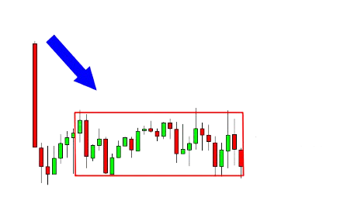
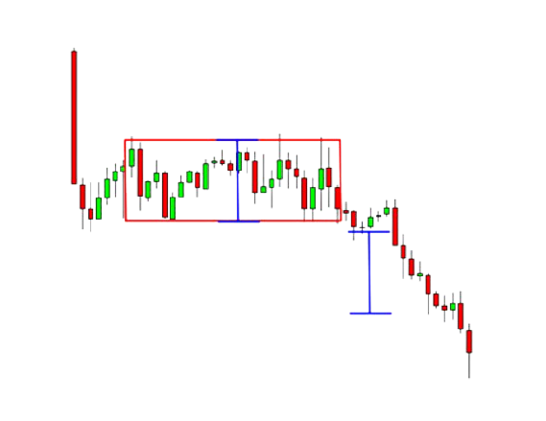
Bearish Rectangles
A bearish rectangle is the inverse condition of the bullish rectangle. It is formed when price consolidates for a while during a downtrend before taking its breakout, downwards.
Downtrend
Rectangle
Price breaks out downwards

Slide 16
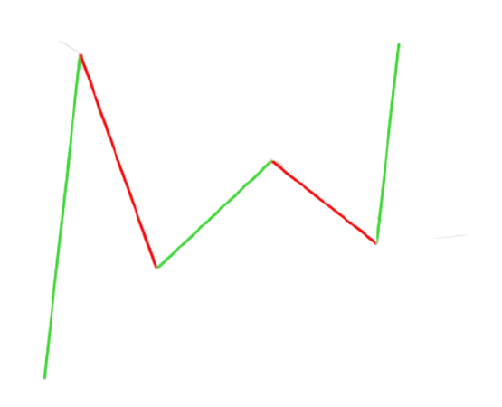
Pennants
After a big move, buyers or sellers usually pause to catch their breath before taking the pair further in the same direction.
Support Line
Because of this, the price usually consolidates and forms a tiny symmetrical triangle (symmetry is with the support and resistance lines ), which is called a pennant.
resistance Line
More buyers or sellers usually decide to jump in on the strong move while the price is still consolidating, this forces price to bust out of the pennant formation on either directions of the market.

Slide 17
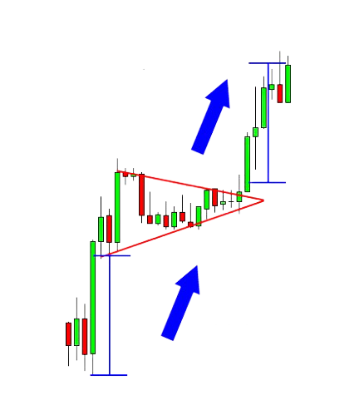
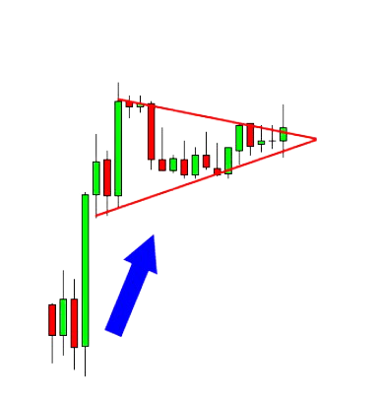
Bullish Pennants
In this example, the price made a sharp vertical climb before taking a brief consolidation.
Afterwards, the price broke out upwards to continue the bull trend.
Uptrend continues
Consolidation
Uptrend
Uptrend

Slide 18
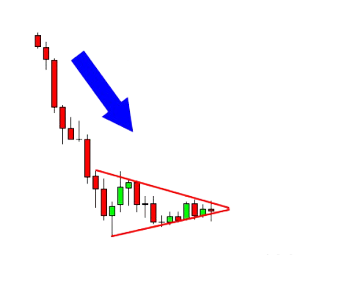
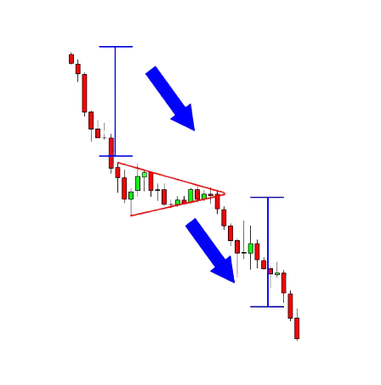
Bearish Pennants
downtrend
A bearish pennant is formed during a steep, almost vertical, downtrend.
After the sharp drop in price, some sellers close their positions and some others join the trend, this causes price to consolidate temporarily.
Brief consolidation
The drop resumed after the price made a breakout to the bottom as a result of new influx of bears and possible exit of more bulls.
downtrend
To trade this chart pattern, we’d put a short order at the bottom of the pennant with a stop loss above the pennant.
Downtrend continues

Slide 19
Triangle pattern
A triangle chart pattern is created when price move into a tighter and tighter range as time goes by. It is often considered a continuation pattern.
A triangle pattern is generally considered to be forming when it includes at least five touches of support and resistance.
Popular triangle patterns
Symmetrical Triangle
Ascending Triangle
Descending Triangle

Slide 20
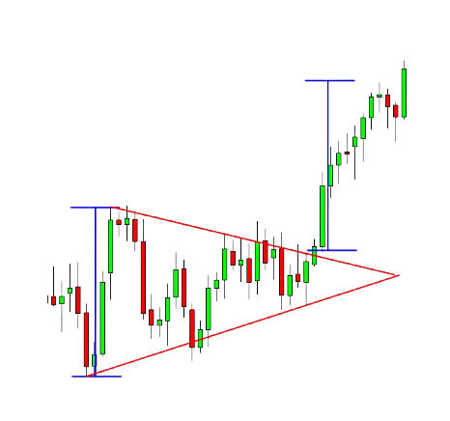
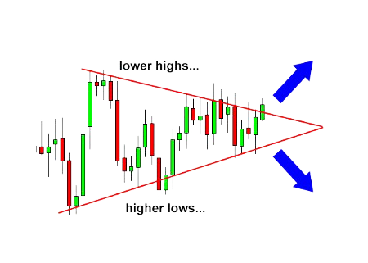
Symmetrical triangle
The slope of the price highs and lows converge together to a point where it looks like a triangle. It’s a type of price consolidation
Price surged up

Slide 21
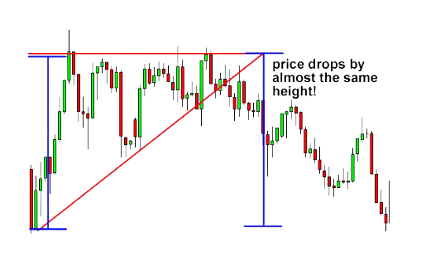
Ascending triangle
An ascending triangle is a type of triangle chart pattern that occurs when there is a resistance level and a slope of higher lows.
Although price goes up most of the time, it is important to note that the breakout could take any direction.

Slide 22
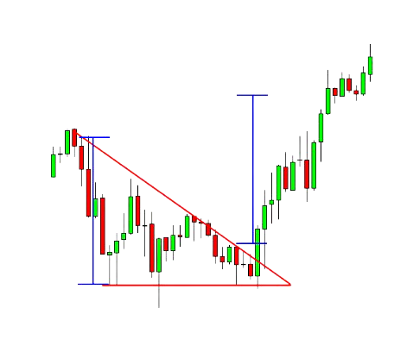
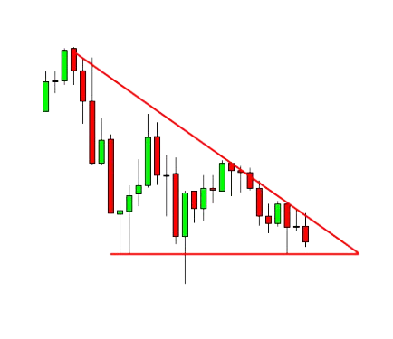
Descending triangle
Descending triangles are the exact opposite of ascending triangles.
There is a set of lower highs that forms the upper line. The lower line is the strong support level.
The trade entry signal is the same price breakout signal peculiar to other Triangles.
Lower High
Price broke out upwards
support
Consolidation area

