Slide 1
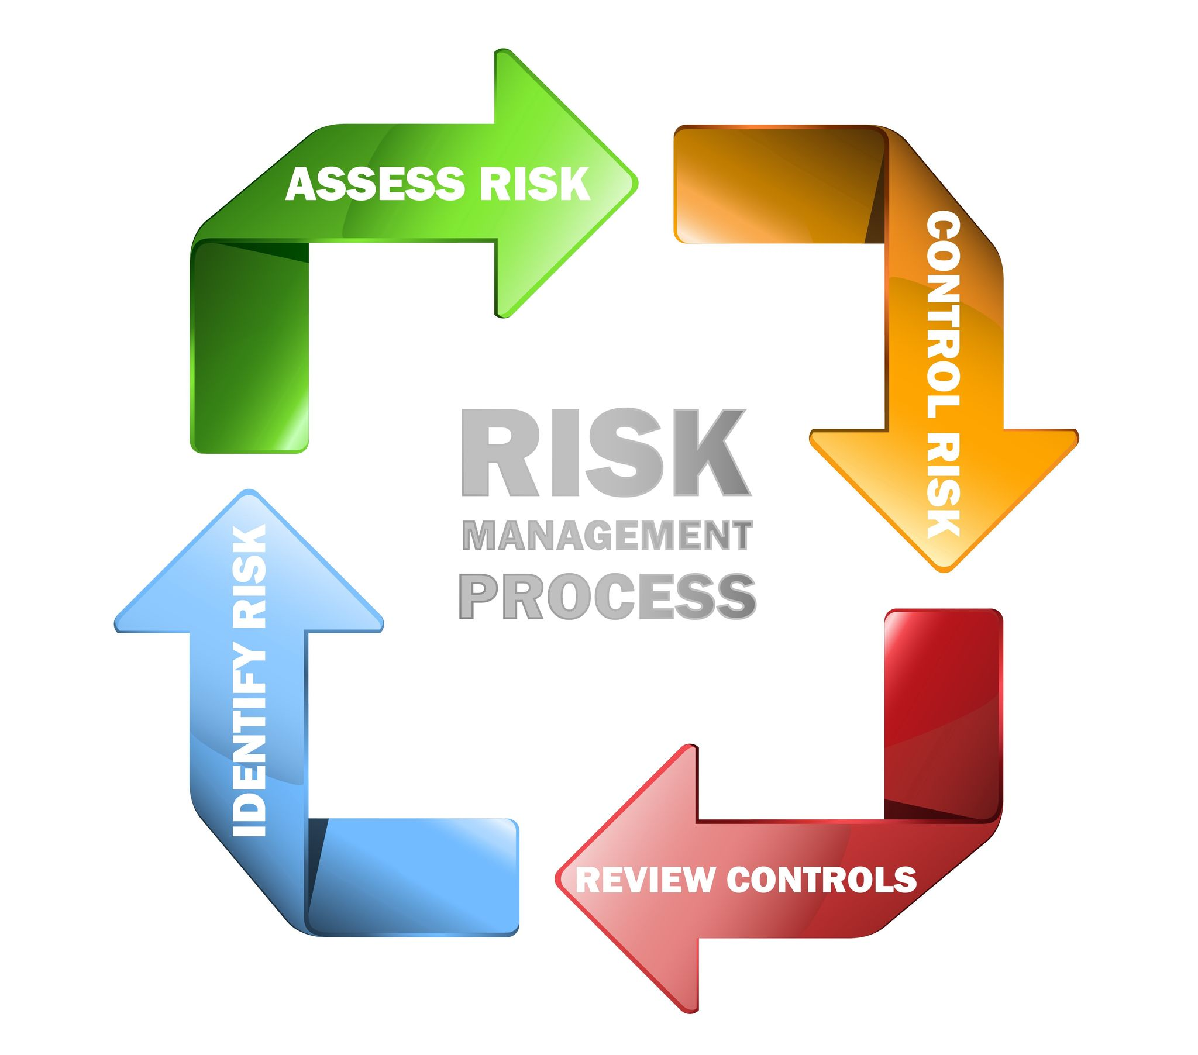
RISK MANAGEMENT
Risk management involves the forecasting and evaluation of Trade risks while identifying procedures to avoid or minimize their impact.
In the financial market, risk management is made top priority by professional traders considering the high volatility of price of most tradable instruments in short time Frames.
Notable Quotes
The essence of investment management is the management of risk not the management of returns— Benjamin Graham
The goal of a successful trader is to make the best trades, money is secondary— Alexander Elder.
A management decision is irresponsible if it risks disaster for the sake of a grandiose future. — Peter Drucker
If you don’t know the Jewelry, know the Jeweler— Warren Buffett.

Slide 2
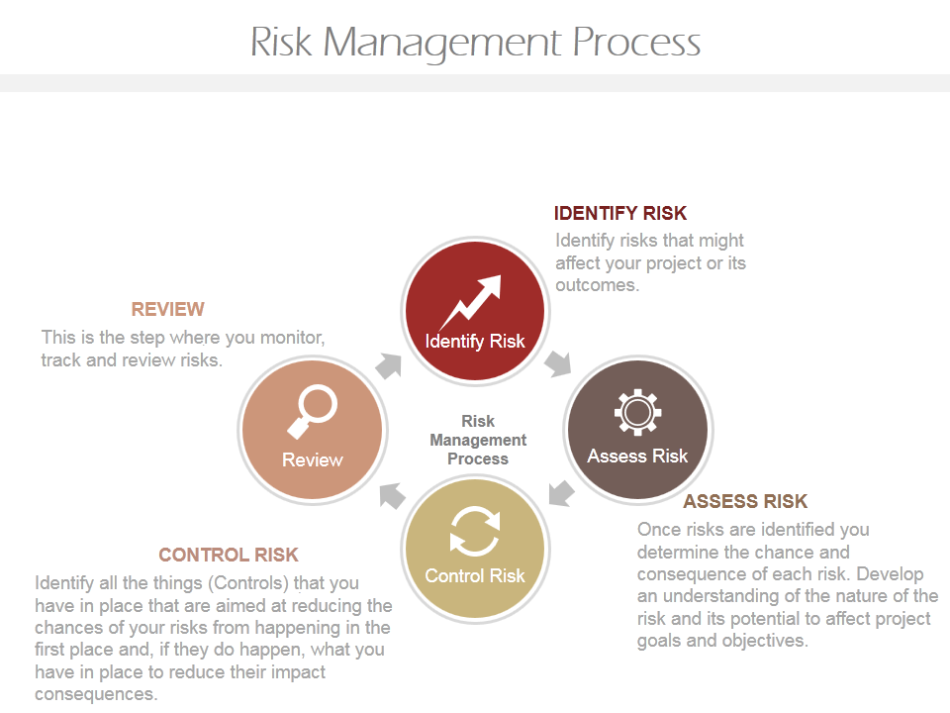

Slide 3
Traders Capital
Trading the financial market requires two assets; Traders capital and Traders psychology.
Lot Sizing: This determines how much of your capital is exposed for each pip movement on every trade executed in the market.
Standard Lot; 1.0 = 100 000 units (Base instrument)
Mini Lot; 0.1 = 10 000 units ( Base instrument)
Micro Lot; 0.01 = 1000 units ( Base instrument)
Nano Lot; 0.001 = 100 units (Base instrument)
E.g. Purchasing a standard lot; 1.0, of USO/USD involves buying 100 000 units of USO ( United states Oil ) and inversely selling the same units of USD; the counter instrument.
A mis-management of any of these two assets would set back the ultimate goal; to make a given amount of profit at a set time.
Hence a trading strategy that does not factor in suitable risk management practices is bound to destroy the traders Assets.
In the words of Alexander Elder, a prudent trader manages his capital as carefully as a scuba diver does his Oxygen.

Slide 4
Calculating Pip Value: A pip is the unit of price displacement on any traded financial instrument (FX and CFDs). To calculate this successfully,
Decimal place X Trade size
Current market price
USD/JPY Pip Value = 0.01 X 1000 = 0.07$ / Pip
for a Micro-lot size 134.99
EUR/USD Pip Value = 0.0001 X 1000 = 0.10€ / Pip
For a Micro-lot size 1.0204 = 0.10$ /Pip
Average True Range: This is an indicator that is used to calculate the average Pip displacement in a given market at a fixed period of time.
Prices are traded in two basic decimal forms
4 Decima places; 0.0001
2 Decimal places; 0.01
Most Commodities , stocks, Indices and JPY currency pairs have their prices calculated in 2 decimal places whereas, major currency pairs and some other instruments take the 4 decimal place model.
Stop Orders: These are used my trader to automate the closure of open orders. Profits and losses are taken making use of stop orders theses measures give a prudent trader some degree of control over the outcome of his trade entries in a highly volatile market.

