Slide 1
Market Studies
The primary goal of a trader is to discover the nature and character of the Market and take trade decisions based on the result of these studies.
The ability to do this effectively, comes only through practical experience otherwise called screen time.
One can learn about several approaches to studying the market, set up workable trading plans and still not be successful managing a trading account in the long run ( no surprise, this is the dilemma of many traders around the globe.
Profitability comes from rightly applying this knowledge and growing confidence in your trading plan over time (screen time). A good coach and wild enthusiasm would shorten the leaning curve.
It is recorded that about 90% of trading activities in the financial market is speculative hence we can say that speculation is the spirit of the financial market.

Slide 2
Speculation
This involves studying historical Data of a given event and making forecasts of future outcomes based on the Data studied.
For better studies, this Data is often placed on a chart, this aids represent it graphically for better observation and analysis. On this chart traders tend to note reoccurring patterns and trends this goes all the way to facilitate speculation.
Often times traders separate modes of analysis into three, Here we have;
Mode of Analysis | Basic Application
The Technical Approach | This takes advantage of charts and statistical tools to make speculations
The Fundamental Approach | Following the outcome of Economic News and Events of the Financial Market
The Sentimental approach | This involves paying attention to the net positions of other traders in the market.
Effectively, these modes of trading aren’t distinct from each other, rather they work together to give a prudent trader a wholesome view of the information contained in the market’s activities. Hence better speculative results with more trade entries.

Slide 3
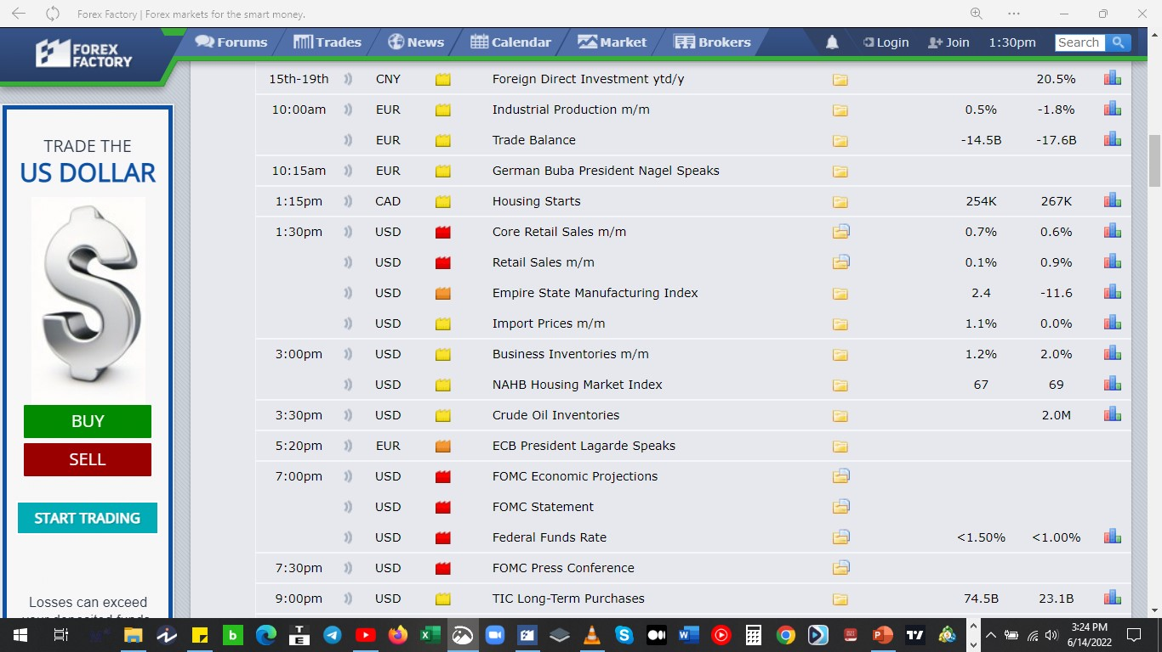

Slide 4
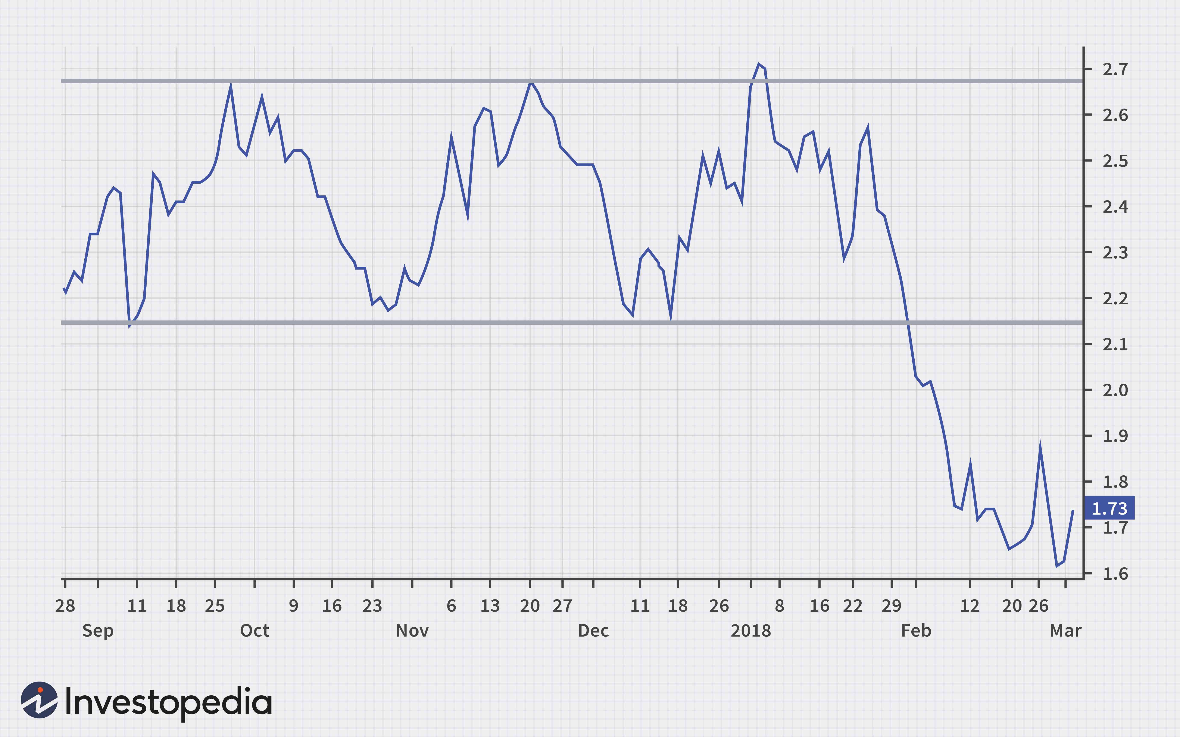

Slide 5
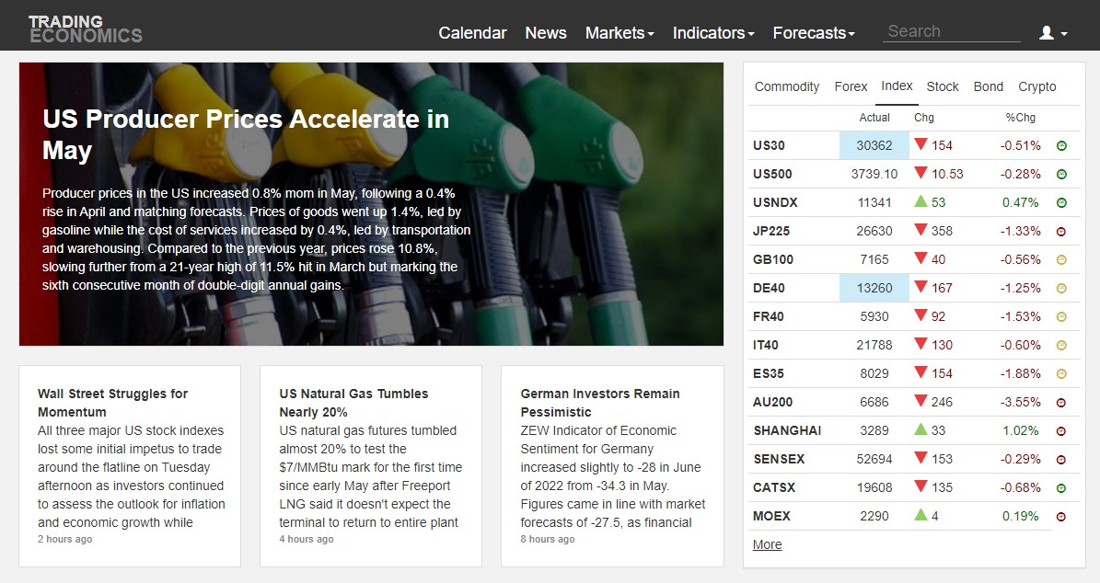

Slide 6
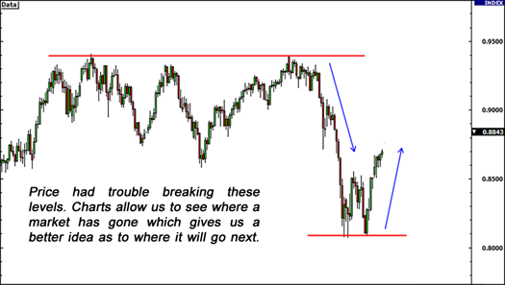
Technical Analysis
This type of analysis involves looking at historical price movements to determine the current trading conditions and potential price movement.
Technical analysts look for similar patterns that have formed in the past and will form trade ideas believing that price could possibly act the same way that it did before.
Fundamental Analysis
This is a way of looking at the forex market by analyzing economic, social, and political forces that may affect currency prices.
The unifying factor
Fundamental factors shape sentiment, while technical analysis helps us visualize that sentiment and apply a framework to create our trade plans.
Sentiment Analysis
Sentiment analysis is used to gauge how other traders feel about a particular currency pair based on the fundamental outlook.
These three work hand-in-hand to help us come up with good trade ideas.

Slide 7
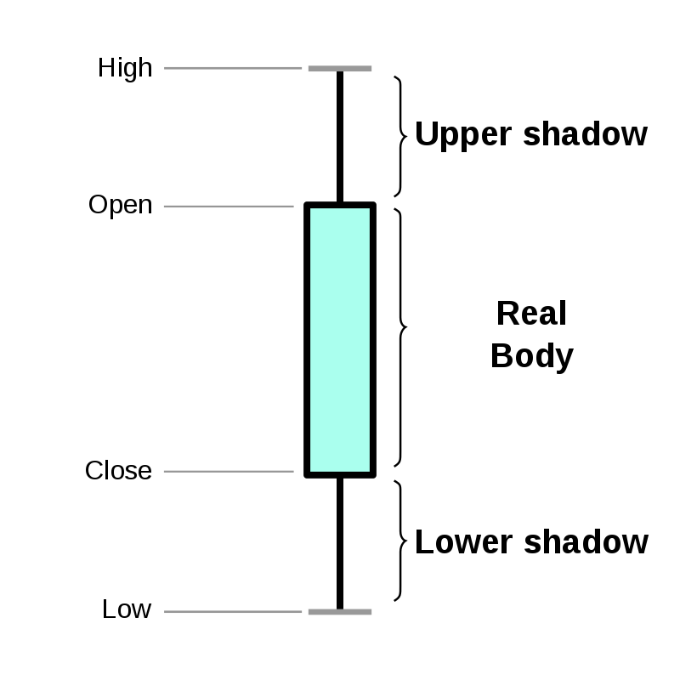
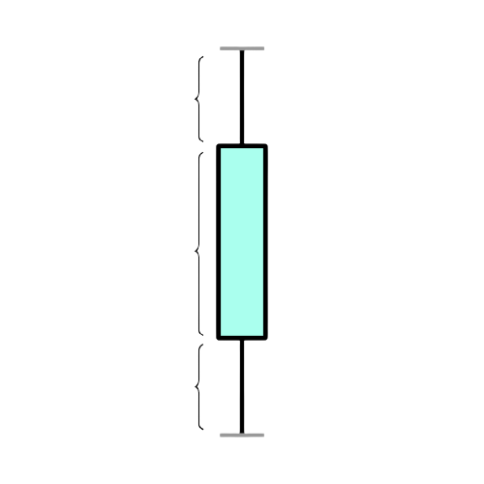
Fundamental factors shape sentiment, while technical analysis helps us visualize that sentiment and apply a framework to create our trade plans.
Since we can visualize this market sentiment from studying the charts, its safe to say that we can be profitable trading by simply evaluating market sentiment from effectively studying price action in time all on the charts.
Considering the above statement we cannot underestimate the power of market sentiment. In other words we cannot ignore the trend.
Candle Sticks
The candle stick has been one of the most effective charting system for studying price action. Simply put, it give us a 3D view of the market price action In contrast to the usual line charts.
As we established earlier; market sentiment is simply the net position of all the traders in the market at a given time. It could either be Bullish, or Bearish.
Position | Implication | market outlook
Bullish | Buyers holding more volume of trade than sellers at a given time. | Demand increases against supply; Price goes up.
Bearish | Sellers holding more volume of trade than buyers at a given time | Supply increases against demand; Price goes down.
High
Close
Open
Low

Slide 8
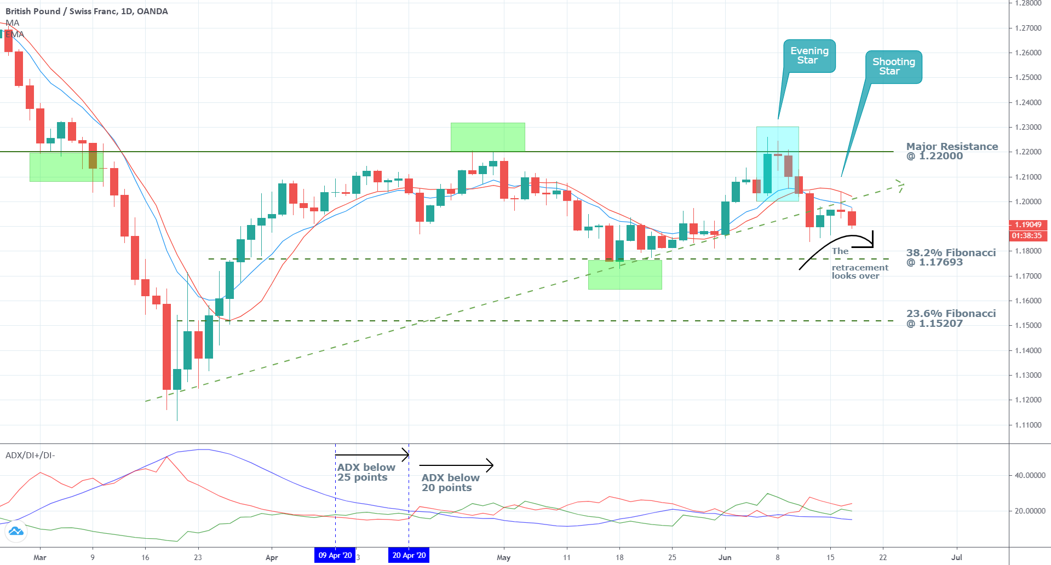

Slide 9


