Slide 1



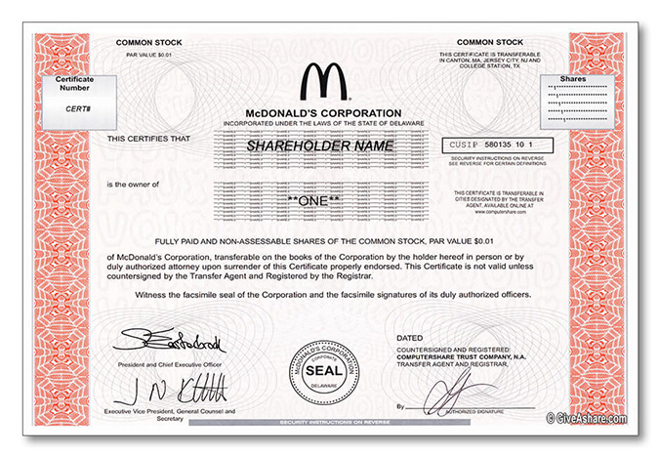
Trade, definition: Trade broadly refers to the exchange of goods and services, most often in return for money.
Financial Market: Financial markets refer broadly to any marketplace where the trading of securities /assets occur.
Goods Muffin cake:
Two Pieces = N 1000
Services
Teaching:
An Hour session = N 10 000
Securities Stocks:
Value Per share = N 150
Most tradable assets that do not fall under the category of goods and services ( mostly intangible assets) are often grouped in the class of securities. They are represented by a document of entitlement to rights under the security.. e.g. C of O, Bonds, Stocks, Mutual Funds, NFTs, Etc.

Slide 2
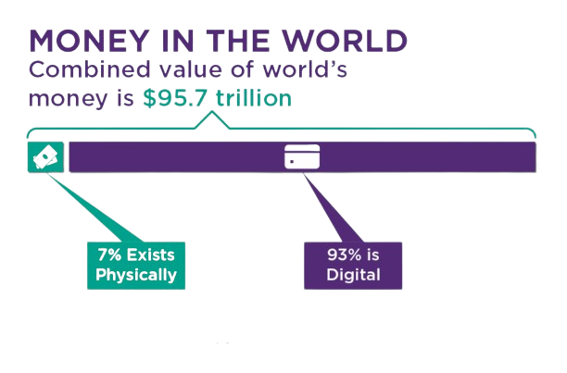
Financial Market Facts
We have here, a highly liquid market which implies massive trading activities.
It’s made up of Multinational corporations, Governments, local businesses and individuals trading financial instruments.
large deals of trading activities in the financial market is done OTC (over the counter ).
The financial market is highly relevant to the sustenance of the Capitalist economy.
Private Institutions can expand their capacity through IPOs. in the Stock market.

Slide 3
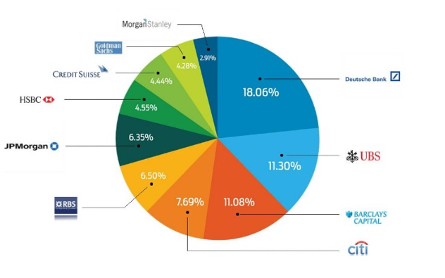


Major Participants in the Financial Markets
Central Banks
The central Banks Manage foreign reserves
and maintains an account of the national budget.
Commercial banks have their accounts at Central Banks.
Via Interest Rates and Monetary Policies, they regulate the entire banking activities of the Nation.
CBN
(Nigeria)
FED
(United states)
Super Banks
These class of banks trade Millions of Dollars in the financial market(without Leverage) and carry out large volume transactions for their clients (multinational corps. and gov. bodies) with the aid of Interbank electronic transaction platforms e.g. Reuters…
Top super banks and their order volumes in the Financial Market

Slide 4
Major Participants in the Financial Markets
Retail Traders
These involve individuals and small to medium scale businesses trading via a provider, called a broker otherwise…Dealer. The Profitability of retail traders depend on their trading strategy, money management skills, experiences and also the services of a fair and Honest Broker. According to the statistics, the higher the trader's capital, and most of the time Risk management makes most of the difference between successful and armature traders.
Brokers
Brokers fundamentally provide their clients with access to the financial markets via electronic trading platforms. For executing their clients' trades, the broker usually gets a commission. Globally, there are hundreds of brokers with various approach to serving their clients.
A fact is that the vast majority of retail traders lose their capital in the financial market, and many brokers put their own profits ahead of creating a profitable trading environment for their clients. Many brokers therefore, chose dishonest and cruel practices that accelerate the loss of their client's capital, and they directly benefit from the losses of their clients (a fair broker would only profit from a spread or commission and not from clients' losses).
Other financial institutions
These include, insurance companies, Hedge funds and several other investment houses.
They usually execute their transactions through a Broker with institutional solutions or Banks, they often trade for speculation purposes ( like the retailer) and risk management (hedging) for their clients.

Slide 5
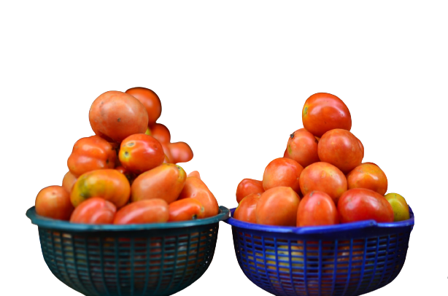


It’s all about value
In all forms of trading, value is the principal subject.
A trader of any goods, service or security acts as a bridge for seamless transfer of Value.
A trader Believes that for every asset available there is someone willing and ready to buy or sell it usually for more value than it was purchased or bought respectively.
A skilled Professional ( Teacher etc. ) : Trades knowledge and/or expertise for an asset or security agreed upon the transaction
A typical trader/ business man; as we often call it purchases goods, services or securities and
makes them available to a part of the market that need its at the time at an agreed cost.
In all, individuals and organizations get into Trade for the sole purpose of exchanging value for profit at given periods of time.
Market A
40pcs / basket. 2000 N
Price Difference
300 N / Tray
Trader
( Annie )
Market B
6pcs / Tray 500 N

Slide 6
Categories of financial instruments traded Electronically on the Financial Market
Forex ( currency pairs ) Cable (GBP/USD), Loonie (USD/CAD), Aussie (AUD/USD), Euppy (EUR/JPY) etc. theses are all currency pairs traded electronically in the financial market. The exchange rate of these instruments in time is the price which is traded, because it is constantly in flux, traders make profit from price speculation.
Commodities Commodities are basically raw materials from which other goods are made.
Agriculture: Coffee, Maize, Cotton, Cocoa, etc.
Energy: Crude Oil, Natural gas etc.
Metals: Gold, Platinum, Silver, Palladium, etc.
The global prices of these commodities is being traded in slight contrast to FX.
Indices Indices are more like an aggregate value of a group of stocks e.g. The index of the top 30 companies in US (US 30), the index of the top 40 companies in France ( Franc 40 ) etc.
They are often used to tell the well being of an part of a states economy. Since the price value fluctuates, Traders and investors alike take advantage of these moves.
Stocks These are simply part ownership of companies acquired in public offerings by individuals these asset class have global price tags on them influenced by their demand and ultimately, the overall performance of the business.

Slide 7
Primary Elements that Influence a Market
Price
Price represents the value agreed upon a definite asset or service at every given time.
The market price of an asset or service is determined by the forces of supply and demand. A price consensus is reached in a given time when the quantity and volume demanded and supplied is equal.
Time
A unit for Recording past, present and future events.
Supply
This is the direct opposite of demand in the market. It is the volume and quantity of a given asset or service being made available by sellers in a market at a given time.
Demand
This represents the Volume and quantity of a particular asset being purchased by buyers in a market at a given time.
All of these primary elements of trade are interwoven to form the right story of every market, hence; to stay in profitable business, a diligent trader needs to understand these factors individually, understand how they relate with each other and ultimately learn how they influence market behavior.
It is important to note that time is the one unifying factor… and to understand time, is to set oneself on the right foot for good profitable trades.

