Slide 1







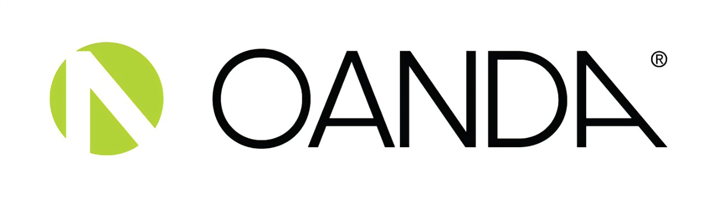

BROKERS
Just like we stated earlier in the previous session, Brokers are notable players in the financial market.
Their primary goal is to execute their clients orders, providing access to financial markets.
For executing their clients' trades, the broker usually gets a commission and (or) spread based on their service models. In the world, there are hundreds of brokers with very different approaches to managing their clients.

Slide 2
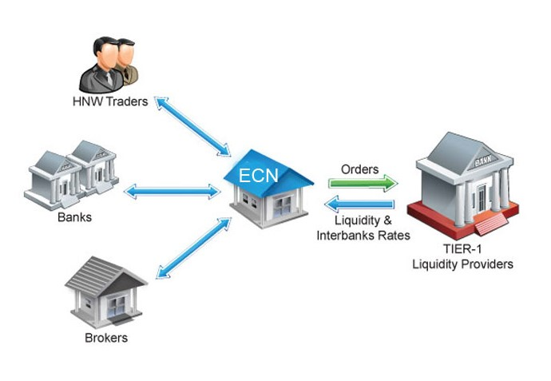
NONE DEALING DESK BROKERS
If a broker offers her clients (traders) direct access to the inter-bank market, (DMA), then they are a None Dealing Desk broker.
This type of broker works on a purely automated trade processing basis and this significantly implies that there are no dealer/broker interference with the trade orders. All your trades are treated the same way, regardless of your trader profile and there are no human intervention.
The ECN technology offers a trade matching system that does not rely only on large institutional players to provide liquidity (Hedge funds and retail traders are involved in this system too). Both buyers and sellers receive the best available price being offered at the time.

Slide 3
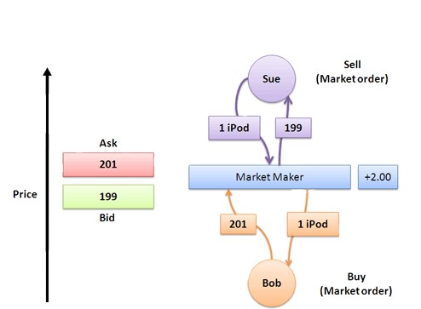
The Market maker are more or less their own liquidity providers and in some other respect, they Partner with a liquidity provider to create a market for traders.
They have the task of maintaining significant trade volume and active market.
As market makers, the dealing desk broker can afford to set their own price quotes and sometimes these prices differ from actual market prices.
They make profit primarily from the difference between the bid price and ask price (bid-ask spread), in contrast to commission used by none dealing desk brokers.
DEALING DESK BROKERS
THE PRIMARY ROLE OF DEALING DESK BROKERS
Matching Orders
Providing Liquidity
Stabilizing Spread

Slide 4
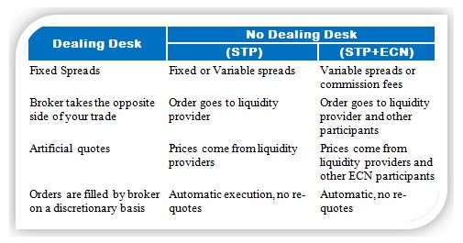
Here are some of the major differences between the notable models of brokerage services.
As traders, it is important for us to know the type of broker we are subscribed to so as to know what to expect from the services offered.

Slide 5
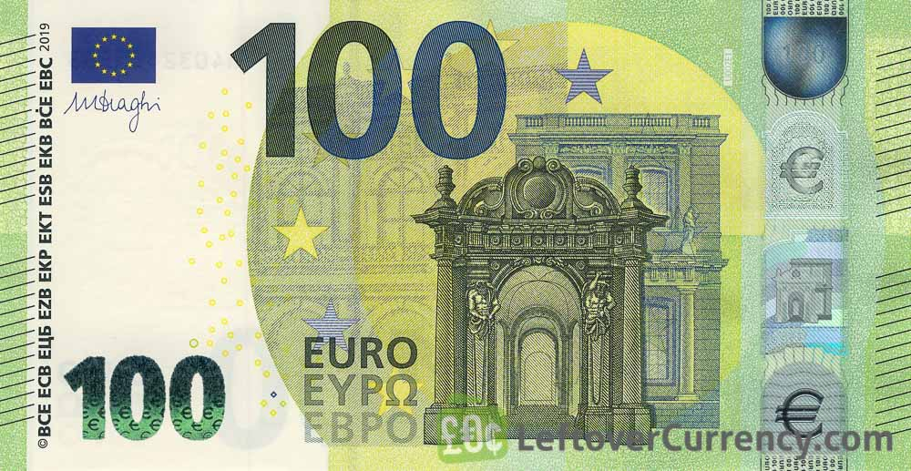
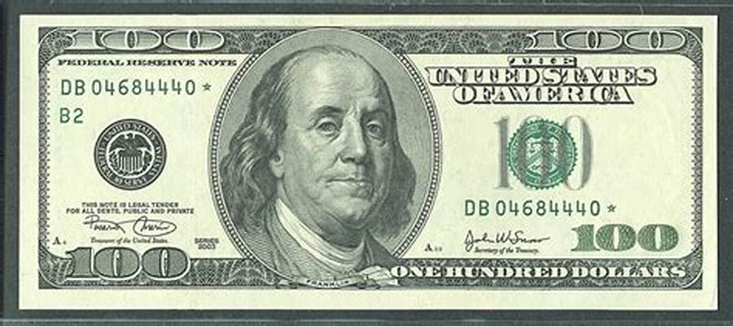
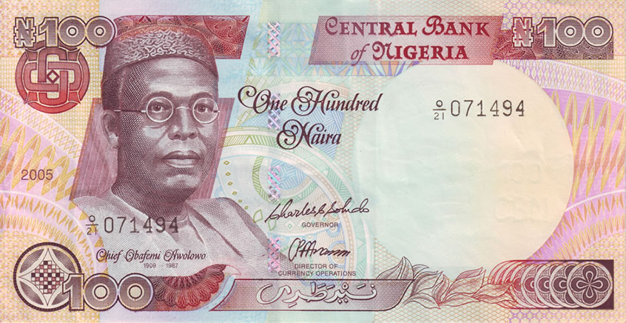
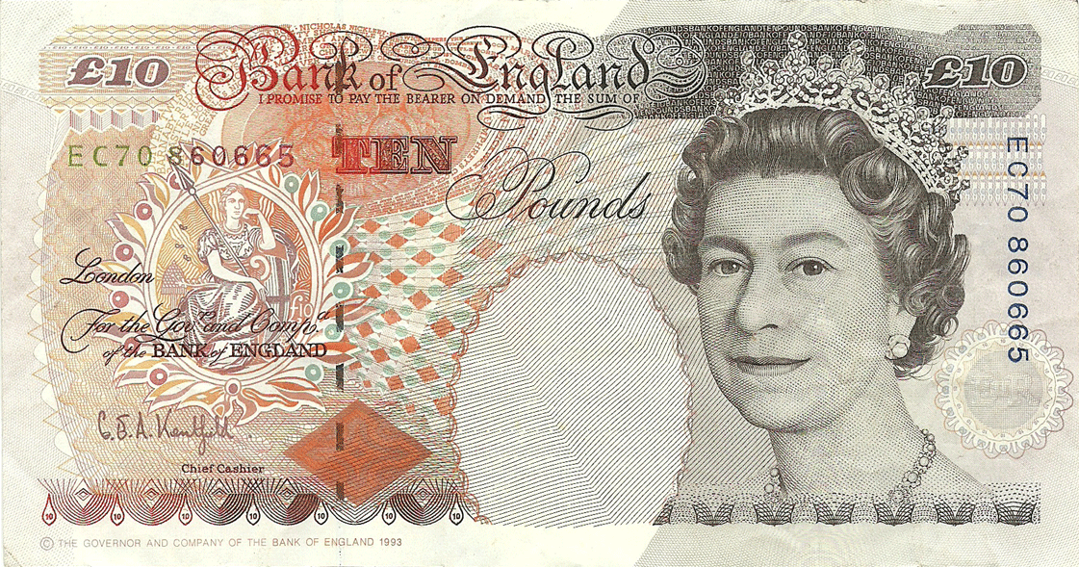








SETTING UP A TRADING ACCOUNT
Fiat Currency
With a typical broker, you can open an account in Dollars which is the most widely accepted currently globally. Most brokers presently offer trading accounts in Our Local Currency Naira as well as other Notable currencies like British Pounds Euros Australian Dollars and Canadian Dollars
Crypto currencies
Since the popularization of the crypto market a large number of brokerage services now offer deposits in Bitcoins USD tether, Ethereum and other widely accepted cryptos with high market capitalization
Payment platforms
Other popular payment gateways include Local and Domiciliary Bank accounts, Net teller, Web Money, Skrill etc.

